Slide 1
Public speaking: Content

Slide 2
Modes for persuasion/ Rhetorical appeals
A common thread among most great speeches is the use of Aristotle’s three modes of persuasion—Ethos, Pathos, and Logos. These are commonly known as Aristotle’s Appeals or rhetorical appeals.
Ethos
An appeal to ethics
Pathos
An appeal to emotions
Logos
An appeal to logic and reason

Slide 3
Modes for persuasion/ Rhetorical appeals
Aristotle used these three terms to explain how rhetoric works:
“Of the modes of persuasion furnished by the spoken word there are three kinds. The first kind depends on the personal character of the speaker [ethos]; the second on putting the audience into a certain frame of mind [pathos]; the third on the proof, or apparent proof, provided by the words of the speech itself [logos]. Persuasion is achieved by the speaker's personal character when the speech is so spoken as to make us think him credible.”

Slide 4
Modes for persuasion/ Rhetorical appeals
PATHOS
Emotion/ Values
ETHOS
Credibility/ trust
LOGOS
Logic/reason/proof

Slide 5
Modes for persuasion/ Rhetorical appeals
Rhetorical appeals | Main technics
ETHOS | Personal branding; confidence in delivery; cites credible sources
PATHOS | Stories; inspirational quotes; vivid language
LOGOS | Structure of the speech (opening/ body/ conclusion); references to studies, statistics, or case studies; comparisons, analogies, and metaphors

Slide 6
Modes for persuasion/ Rhetorical appeals
Sample Paragraph
A small dog sits in a dark, cold garage. His hair is matted and dirty; he is skinny and weak from going days without food. There is no water for him to drink, no person to give him love and no blanket to keep him warm at night.¹ While this might be a hard scenario to imagine, it is not an uncommon one in America today. According to the Humane Society of the United States, nearly 1,000,000 animals are abused or die from abuse every year.² As a veterinarian with 30 years of experience, I have seen how even one incident of abuse can affect an animal for the rest of its life.³ As a society, we need to be more aware of this terrible problem and address this issue before it gets worse.
¹Pathos ²Logos ³Ethos
Pathos, Logos, and Ethos. (n.d.). St. Louis Community College. Retrieved June 14, 2022, from https://stlcc.edu/student-support/academic-success-and-tutoring/writing-center/writing-resources/pathos-logos-and-ethos.aspx
Notes:
¹Pathos: the author paints a vivid picture to evoke a feeling from the reader—sadness and pity for the abused animal.
²Logos: the author uses a startling statistic to appeal to our intellect. Keep in mind that these three strategies can often overlap. This sentence qualifies as both Logos and Ethos because it cites a reputable organization, so we know the author is using credible sources.
³Ethos: the author establishes their own credibility by stating their occupation and experience.

Slide 7

Modes for persuasion/ Rhetorical appeals

Slide 8
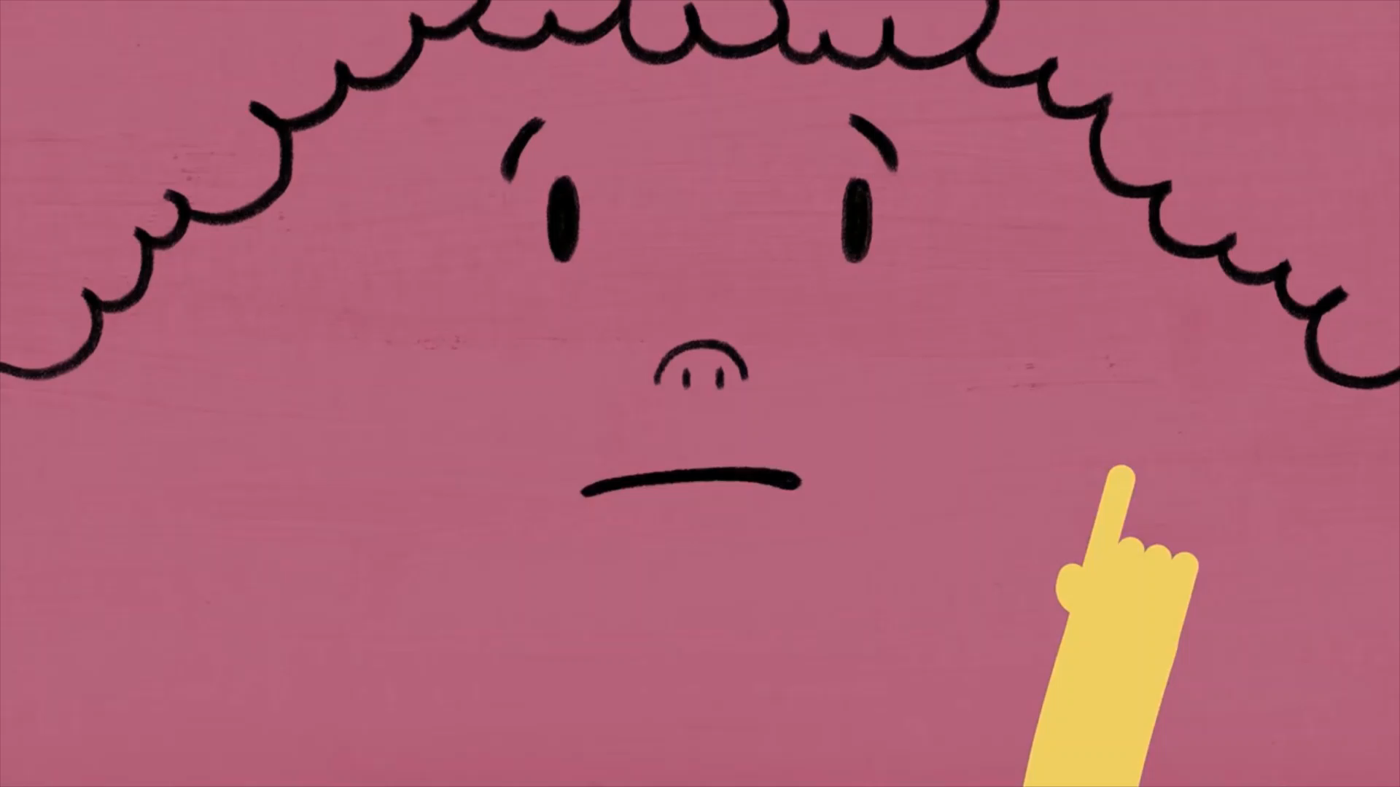
Modes for persuasion/ Rhetorical appeals

Slide 9

Examples of Ethos, Pathos, and Logos I

Slide 10

Examples of Ethos, Pathos, and Logos II

Slide 11


Presentation vs. conversation

Slide 12

Your audience

Slide 13
Your audience
Audience expectations
Their knowledge of topic
Attitude toward topic
Audience size
Demographics
Setting
Voluntariness
Egocentrism

Slide 14
The structure of a presentation
What are the two elements for a powerful presentation in your opinion?
How do you help your audience know where you are in a presentation?

Slide 15
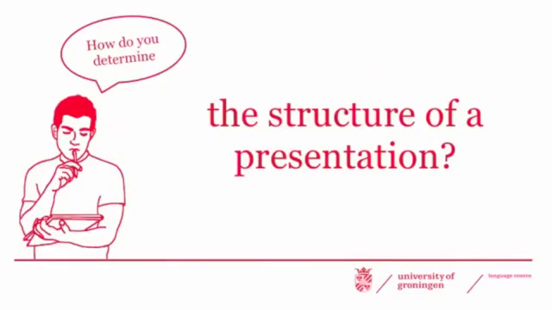
The structure of a presentation

Slide 16
How do you present logically?
Adding titles to your slides in PowerPoint
Using transition words and phrases when giving the talk (e.g., first/firstly, second/secondly, third/thirdly, etc.)

Slide 17
How do you present logically within paragraph?
Maintaining the one-idea-one-paragraph structure
Building your idea based on deductive reasoning
Using sentence pattern to achieve a linear flow

Slide 18
One paragraph one idea
Focusing on the main idea
Ensuring unity, coherence and evidence-based explanations of the idea

Slide 19
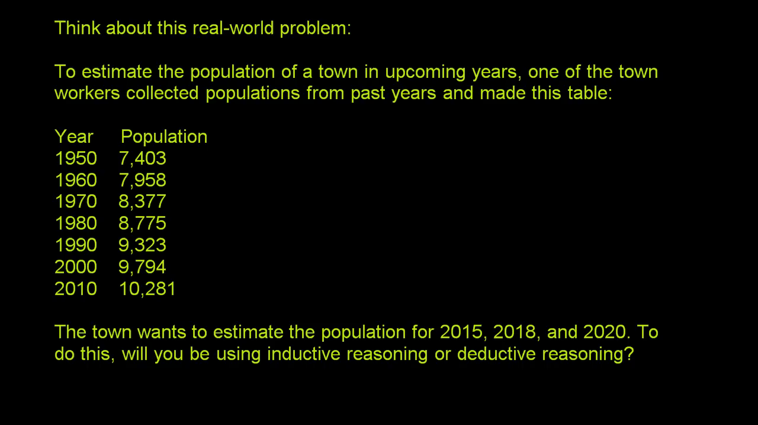
Deductive reasoning

Slide 20

Linear flow
the theme of the previous sentence becomes a topic of the following sentence

Slide 21
How do you present logically between paragraph?
Selecting unified ideas that support the main idea in each paragraph
Creating effective connections between paragraphs

Slide 22
Effective connections
Transitional words - Indicating the relationship between each idea
Transitional sentences - Summarizing the topic of the previous paragraph & establishing a connection between the previous topic and the next one
Transitional paragraphs - Describing the large section & transitioning reader to new information

Slide 23
4 types of transitions
Additive: adding new information
Adversative: distinguishing information
Causal: showing the causes, effects, etc.
Sequential: organizing information by number

Slide 24
Some tips - 3 rules of 3
Pick 3 items - sticking to 3 because your audience won’t remember more
Say it 3 ways - saying it from different angles will add clarity and understanding
Say it 3 times - repetition help them remember it

Slide 25

Some tips - 3 rules of 3

Slide 26
The end: more than repetitions
Refocusing the main points
Reiterating your purpose
Reinforcing what’s important
Laying down a challenge
Looking to the future

Slide 27
Let’s end here
Avoid introducing new evidence
Avoid opening a new line of argument

